Slide 1
Seam Carving
Noah Sherry

Slide 2

Input Image

Slide 3
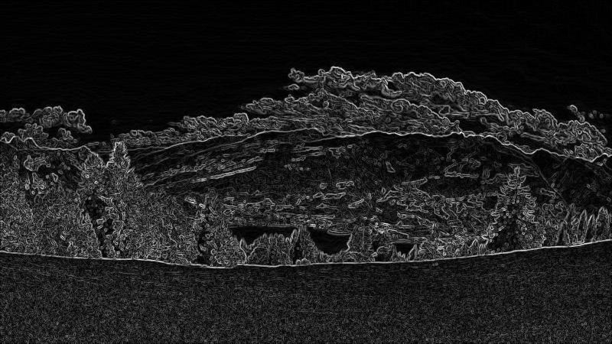
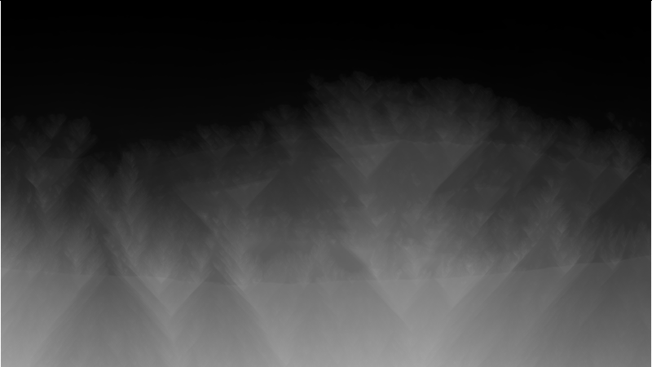
Vertical Seaming
edge_kernel=np.float32([[1,2,1],[0,0,0],[-1,-2,-1]]) Iy=cv2.filter2D(img*1.0,-1,edge_kernel) Ix=cv2.filter2D(img*1.0,-1,edge_kernel.T) I=(Ix*Ix+Iy*Iy)**.5
x=np.vstack((left,row,right)) x=x.min(axis=0)
x+=I[i]
O[i]=x

Slide 4
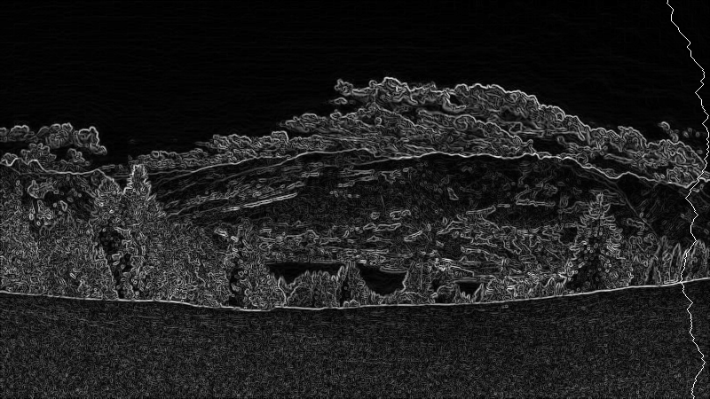
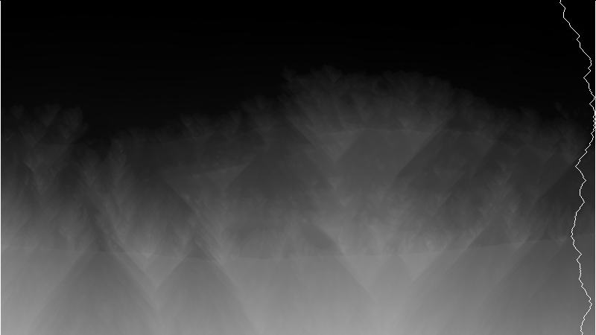
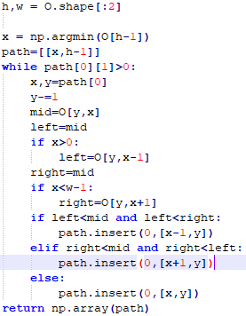

Vertical Seaming (cont.)

Slide 5

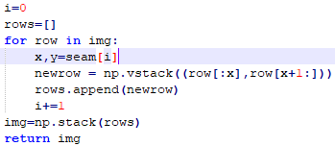

Vertical Seaming (cont.)
<- 1 seam
<- 50 seams

Slide 6
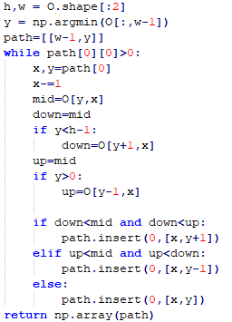
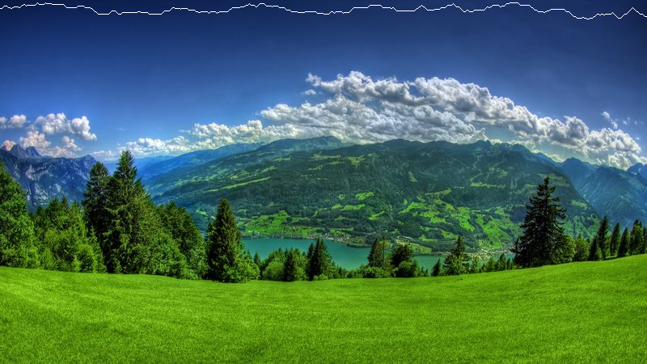

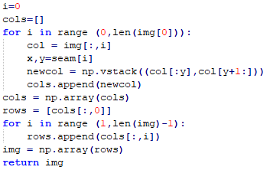
Horizontal Seaming

Slide 7
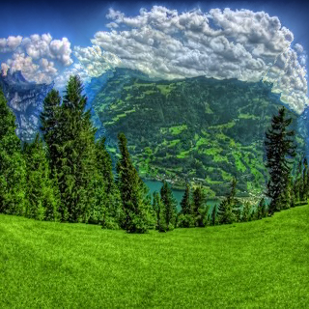
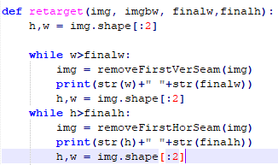
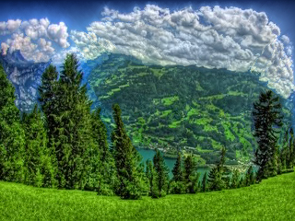
Retargeting

Slide 8

Retargeting (Cont.)

